Slide 1
Classification of Motor Imagery EEG Data on the stm32 mcu and the gapuino board
Machine Learning on Microcontrollers Final Project
Alkinoos Sarioglou
20-947-743

Slide 2
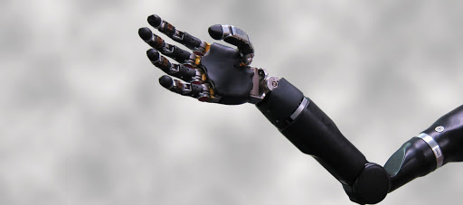
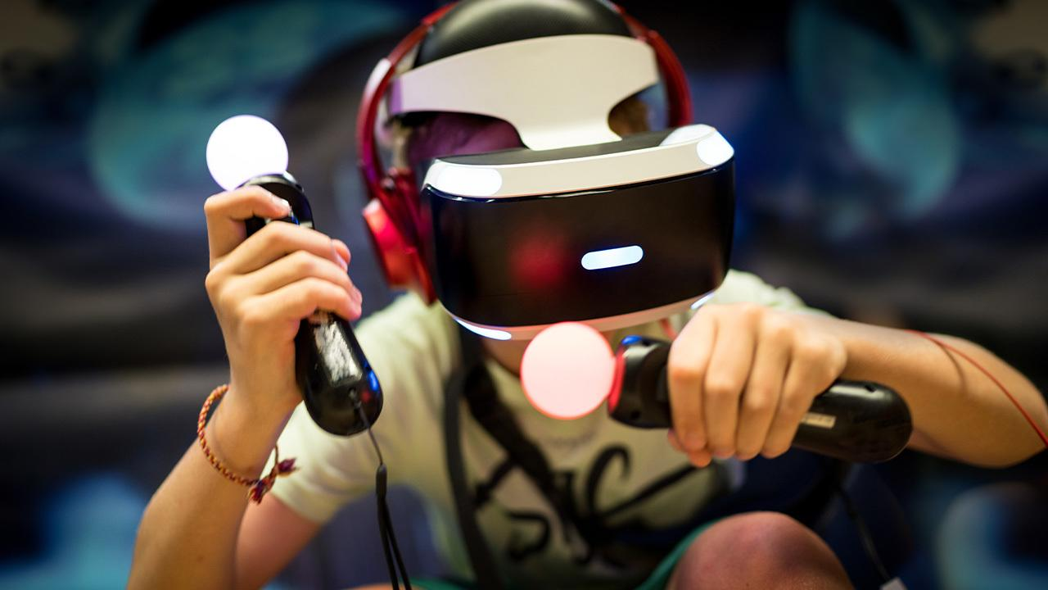
Overview
Dataset: EEG Motor Movement/Imagery Dataset
Goal of the project: Classify the brain signals into 5 classes
Rest
Open Right Hand
Open Left Hand
Open Both Hands
Open Both Feet
Classification using Deep Convolutional Neural Network on the STM32 MCU and the GAPUINO board
Potential applications: Prosthetics/Artificial Limbs controlled by thought, Gaming, AR/VR

Slide 3
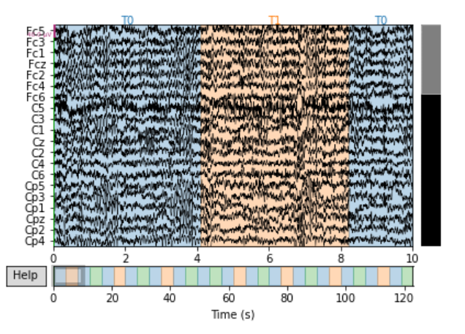
Dataset
EEG recordings taken from 109 subjects
Measurements taken using the BCI2000 system (64 electrodes)
For each subject 6 experimental rounds were examined:
3 times of 2 rounds:
1 round of imagining opening and closing the left or right hand
1 round of imagining opening and closing both hands or both feet
Classification Classes:
Rest {0}
Left Hand {1}
Right Hand {2}
Both Hands {3}
Both Feet {4}

Slide 4
Approach for Training, Validation and Testing Datasets
Steps:
For each task (e.g. Rest) take the Short-Time Fourier Transform (STFT) – 10 windows over 4 seconds
Extract the Fourier Coefficients of the Delta, Mu and Beta frequency bands for each electrode:
Delta band = 0.5 – 4 Hz
Mu band = 8 – 13 Hz
Beta band = 13 – 30 Hz
For each band of each electrode the sum of the squared absolute values is calculated
The result of each band is assigned to the R,G,B channels of a pixel, where each pixel represents a single electrode:
R = Delta Band
G = Mu Band
B = Beta Band
Output of 64 (R,G,B) pixels - each pixel represents an electrode
1 image per window – 10 images per task
300 images per round (30 tasks)
185400 images in total (300 images x 6 rounds x 109 subjects)

Slide 5
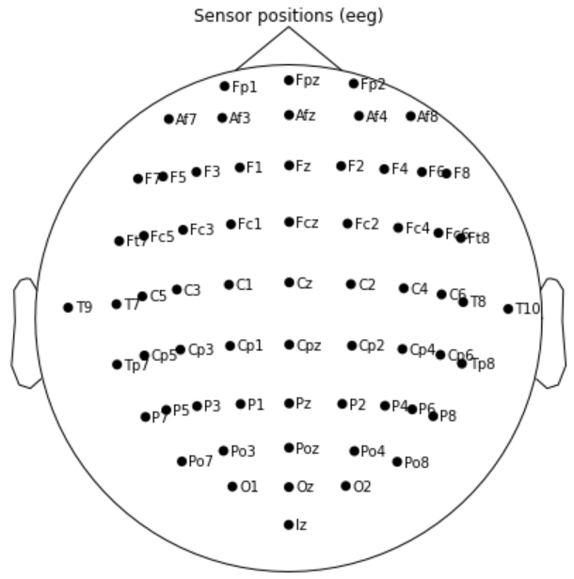
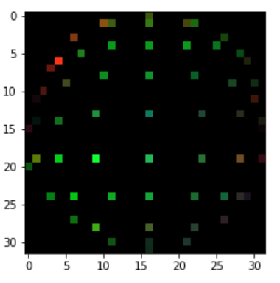
Preprocessing Steps
#1: Extract electrode coordinates in mm and convert them to pixel positions in a 32x32 image
Notes:
Activation regions become visible

Slide 6
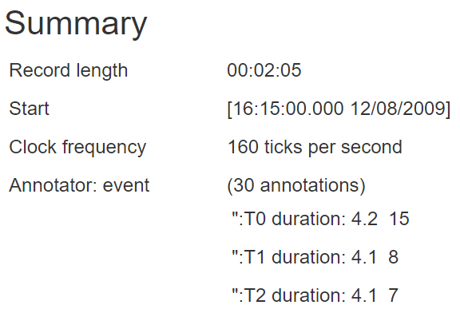
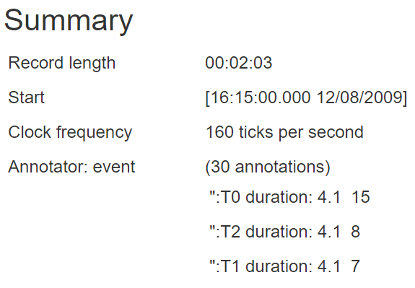
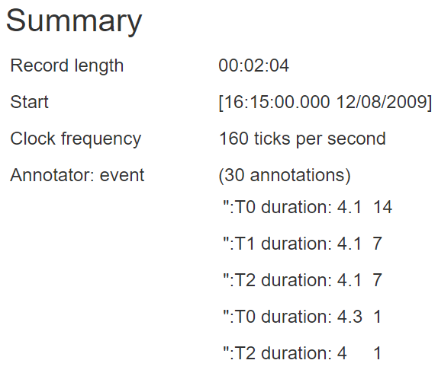
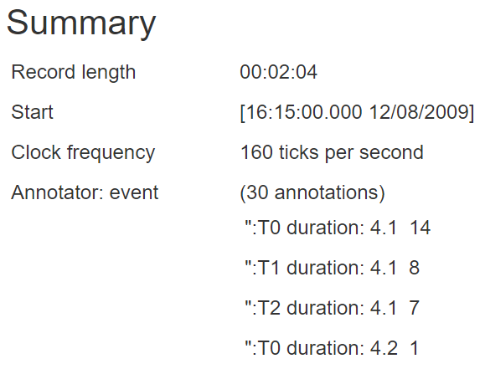
Preprocessing Steps
#2: Separate subjects depending on the task duration in their measurements - 4 groups of subjects
Group A
Group B
Group C
Group D

Slide 7
Preprocessing Steps
#3: Define appropriate windows to examine with the STFT depending on the subject group

Slide 8
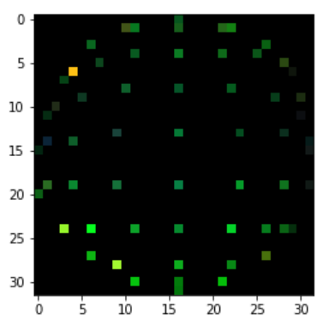
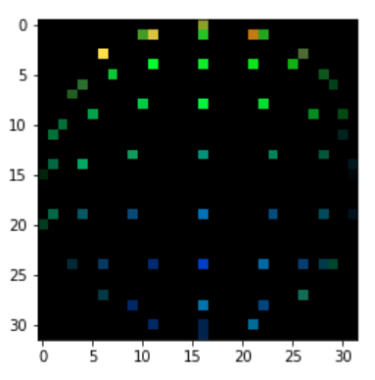
Preprocessing Steps
#4: Read every file and perform STFT for all the windows
Extract Delta, Mu and Beta bands for each window
Perform sum of squares of the coefficients
Assign these values to the R, G, B channels of a pixel
Repeat for every electrode to get 64 pixels

Slide 9
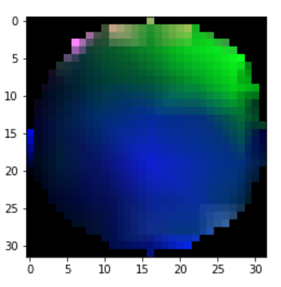
Preprocessing Steps
#5: Assign pixel values to coordinates of the corresponding electrodes
Interpolate between the electrodes (Cubic) to get the full image

Slide 10
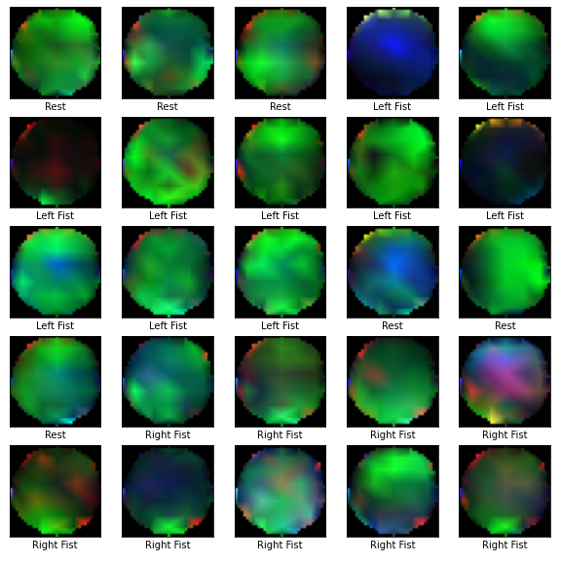
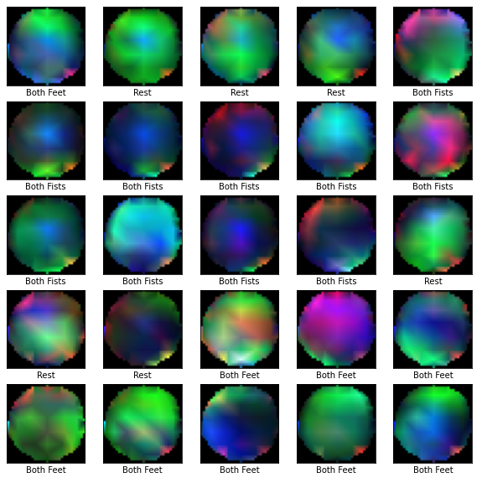
Training, Validation, Testing Datasets
Training Dataset: 185400 32x32 RGB images
Validation Dataset: 1800 32x32 RGB images
Testing Dataset: 1800 32x32 RGB images

Slide 11
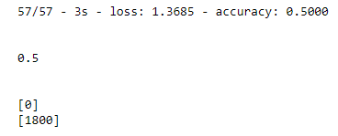
Implementation problems
Problem #1: Unbalanced Dataset – Class 0 dominates the dataset
The distribution of samples:
Class 0
Class 1
Class 2
Class 3
Class 4
Problem #2: CNN with LSTM model proposed by the research paper OVERFITS – Test Accuracy: 50% but NOT USEFUL, just predictions of Class 0
Problem #3: Also consumes a lot of memory!
STM32 – TFLite micro
Proposed Model by Research Paper
Conv2D(64)
Conv2D(64)
Conv2D(64)
MaxPooling2D
Conv2D(128)
Conv2D(128)
MaxPooling2D
Conv2D(256)
Conv2D(256)
ReLU
MaxPooling2D
LSTM(256)
Dense(5)

Slide 12
Implementation and Optimization
Solution #1: Undersampling all classes apart from minority Class 2 - Create a balanced dataset
New organisation of samples: 10 Class 0, 10 Class 1, 10 Class 2, 10 Class 3, 10 Class 4, …
New distribution of samples:
Class 0
Class 1
Class 2
Class 3
Class 4
Solution #2: Remove complexity to fit the memory requirements of the STM32 MCU (STM32 Flash: 1024 KiB, STM32 RAM: 96 KiB) and the GAPUINO board (GAPUINO L1: 48 kB, L2: 307.2 kB, L3: 8.3 MB)
Steps taken:
Less layers
Less filters applied per Convolutional 2D layer
Less LSTM cells

Slide 13
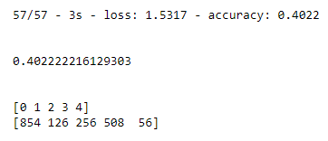
Architecture - 1
Conv2D(32)
BatchNormalization()
SpatialDropout2D(0.5)
ReLU()
MaxPooling2D(2,2)
Conv2D(64)
BatchNormalization()
SpatialDropout2D(0.5)
ReLU()
MaxPooling2D(2,2)
Conv2D(64)
BatchNormalization()
SpatialDropout2D(0.5)
ReLU()
MaxPooling2D(2,2)
Flatten
Dense(5)
LR = 0.01
Batch size = 8
Epochs = 20
Optimizer = SGD
Loss function = Sparse Categorical Crossentropy
Final Accuracy = 40.22%
Final Loss = 1.5317
Quantized Model - Memory STM32 (Flash) = 57.05 KiB (5.57%)
Quantized Model - Memory STM32 (RAM) = 33.36 KiB (34.75%)
TFLite micro TensorArena size = 66336 bytes
STM32CubeAI speed =
164.875 ms (average duration)
13189977 (average CPU cycles)
2.86 cycles/MACC
TFLite micro speed = 33872661 CPU cycles
Notes:
TFLite micro more cycles because of Spatial Dropout 2D
Added Dropout to avoid overfitting
SpatialDropout2D drops entire 2D feature maps instead of individual elements

Slide 14
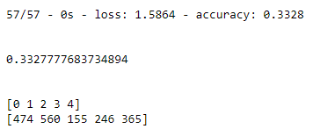
Architecture - 2
Conv2D(32, kernel size = (2,2), stride= (2,2))
Conv2D(64, kernel size = (2,2), stride = (2,2))
Conv2D(64, kernel size = (2,2), stride = (2,2))
Flatten
Dense(5)
Final Accuracy = 33.28%
Final Loss = 1.5864
Quantized Model - Memory STM32 (Flash) = 30.02 KiB (2.93%)
Quantized Model - Memory STM32 (RAM) = 17.94 KiB (18.69%)
TFLite micro TensorArena size = 18000 bytes
Memory GAPUINO = 44620 (Bytes in L1), 43421 (Bytes in L2), 0 (Bytes in L3)
STM32CubeAI speed =
124.58 ms (average duration)
9966411 (average CPU cycles)
11.03 cycles/MACC
TFLite micro speed = 3971615 CPU cycles
GAPUINO speed =
1348719 (Cycles)
904197 (Operations)
0.6704 (Operations/Cycle)
LR = 0.01
Batch size = 8
Epochs = 20
Optimizer = SGD
Loss function = Sparse Categorical Crossentropy
Notes:
This can be run both on STM32 and Gapuino

Slide 15
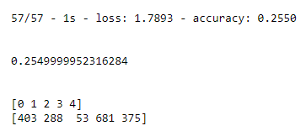
Architecture - 3
Conv2D(32)
MaxPooling2D (2,2)
Conv2D(64)
MaxPooling2D (2,2)
Conv2D(128)
Flatten
Dense(5)
LR = 0.01
Batch size = 1
Epochs = 20
Optimizer = SGD
Loss function = Sparse Categorical Crossentropy
Final Accuracy = 25.5%
Final Loss = 1.7893
Quantized Model - Memory STM32 (Flash) = 94.24 KiB (9.2%)
Quantized Model - Memory STM32 (RAM) = 19.10 KiB (19.9%)
TFLite micro TensorArena size = 43536 bytes
Memory GAPUINO = 47532 (Bytes in L1), 106525 (Bytes in L2), 0 (Bytes in L3)
STM32CubeAI speed =
642 ms (average duration)
51375400 (average CPU cycles)
9.96 cycles/MACC
TFLite micro speed = 20976017 CPU cycles
GAPUINO speed =
934891 (Cycles)
4664613 (Operations)
4.99 (Operations/Cycle)

Slide 16
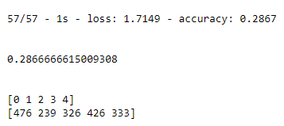
Architecture - 4
Conv2D(32)
BatchNormalization()
ReLU()
MaxPooling2D(2,2)
Conv2D(64)
BatchNormalization()
ReLU()
MaxPooling2D(2,2)
Conv2D(64)
BatchNormalization()
ReLU()
MaxPooling2D(2,2)
Flatten
Dense(5)
LR = 0.01
Batch size = 8
Epochs = 20
Optimizer = SGD
Loss function = Sparse Categorical Crossentropy
Final Accuracy = 28.67%
Final Loss = 1.7149
Quantized Model - Memory STM32 (Flash) = 57.05 KiB (5.57%)
Quantized Model - Memory STM32 (RAM) = 33.36 KiB (34.75%)
TFLite micro TensorArena size = 66336 bytes
STM32CubeAI speed =
164.875 ms (average duration)
13189977 (average CPU cycles)
2.86 cycles/MACC
TFLite micro speed = 33954102 CPU cycles

Slide 17
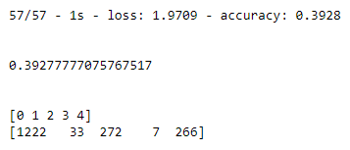
Architecture - 5
TimeDistributed(Conv2D(64))
TimeDistributed(BatchNormalization)
TimeDistributed(ReLU)
TimeDistributed(MaxPooling2D(2,2))
TimeDistributed(Conv2D(128))
TimeDistributed(BatchNormalization)
TimeDistributed(ReLU)
TimeDistributed(MaxPooling2D(2,2))
TimeDistributed(Conv2D(128))
TimeDistributed(BatchNormalization)
TimeDistributed(ReLU)
TimeDistributed(MaxPooling2D(2,2))
TimeDistributed(Flatten)
LSTM(8)
Dense(5)
LR = 0.01
Batch size = 10
Epochs = 20
Optimizer = SGD
Loss function = Sparse Categorical Crossentropy
Final Accuracy = 39.28%
Final Loss = 1.9709

Slide 18
Comparison Plots – Accuracy / loss

Slide 19
Comparison Plots – STM32

Slide 20
selected model – stm32
Architecture 1
Conv2D(32)
BatchNormalization()
SpatialDropout2D(0.5)
ReLU()
MaxPooling2D(2,2)
Conv2D(64)
BatchNormalization()
SpatialDropout2D(0.5)
ReLU()
MaxPooling2D(2,2)
Conv2D(64)
BatchNormalization()
SpatialDropout2D(0.5)
ReLU()
MaxPooling2D(2,2)
Flatten
Dense(5)
LR = 0.01
Batch size = 8
Epochs = 20
Optimizer = SGD
Loss function = Sparse Categorical Crossentropy
Final Accuracy = 40.22%
Final Loss = 1.5317
Quantized Model - Memory STM32 (Flash) = 57.05 KiB (5.57%)
Quantized Model - Memory STM32 (RAM) = 33.36 KiB (34.75%)
TFLite micro TensorArena size = 66336 bytes
STM32CubeAI speed =
164.875 ms (average duration)
13189977 (average CPU cycles)
2.86 cycles/MACC
TFLite micro speed = 33872661 CPU cycles

Slide 21
Comparison Plots – gapuino

Slide 22
selected model – gapuino
Architecture 2
Conv2D(32, kernel size = (2,2), stride= (2,2))
Conv2D(64, kernel size = (2,2), stride = (2,2))
Conv2D(64, kernel size = (2,2), stride = (2,2))
Flatten
Dense(5)
Final Accuracy = 33.28%
Final Loss = 1.5864
Quantized Model - Memory STM32 (Flash) = 30.02 KiB (2.93%)
Quantized Model - Memory STM32 (RAM) = 17.94 KiB (18.69%)
TFLite micro TensorArena size = 18000 bytes
Memory GAPUINO = 44620 (Bytes in L1), 43421 (Bytes in L2), 0 (Bytes in L3)
STM32CubeAI speed =
124.58 ms (average duration)
9966411 (average CPU cycles)
11.03 cycles/MACC
TFLite micro speed = 3971615 CPU cycles
GAPUINO speed =
1348719 (Cycles)
904197 (Operations)
0.6704 (Operations/Cycle)
LR = 0.01
Batch size = 8
Epochs = 20
Optimizer = SGD
Loss function = Sparse Categorical Crossentropy

Slide 23
Thank you for your time and attention!

